Slide 1
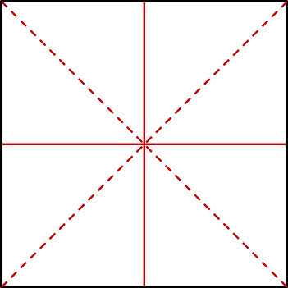
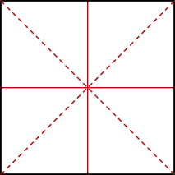
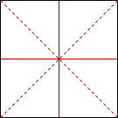

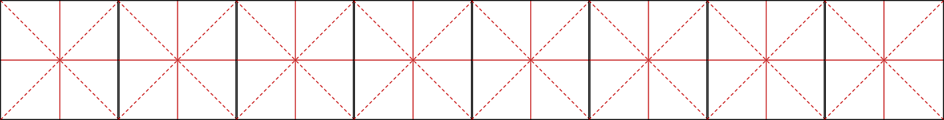

Slide 2
~~~~~~~~~~~~~~~~~~~~~~~~~
abcdefg
ABCDEFG
abcdefg
ABCDEFG
{}{}|\^*

Slide 3



