Slide 1
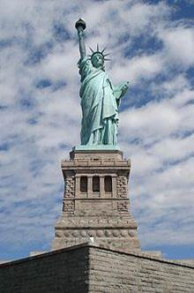
Section Three
Government and Politics(Ⅰ)
英语122班
乔 军 霞
20120401050419

Slide 2
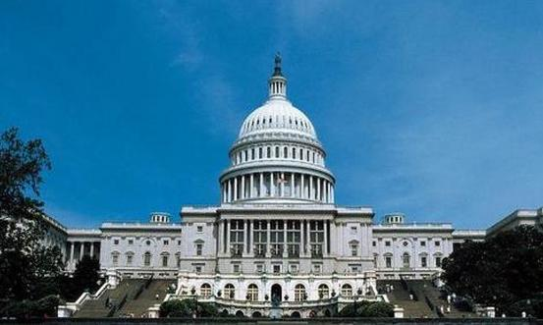

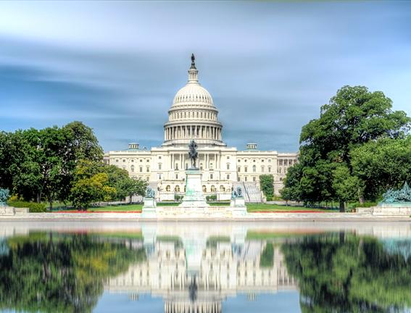
教学目标：The Legislative Branch
教学重点： Function of Congress，Senate &House
教学难点：Senate &House , Legislative Procedure
教学媒体：多媒体教室
白宫与国会大厦很近，建筑风格相似，很多人误以为是同一个建筑

Slide 3
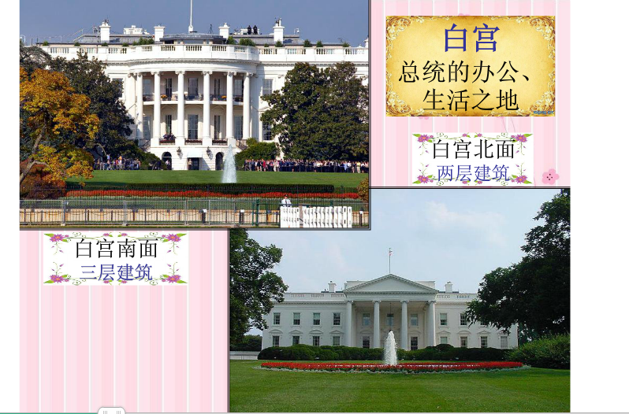
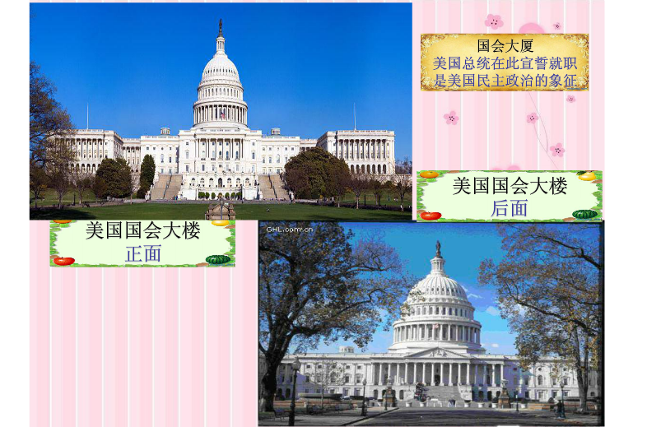
白宫是政府所在地，国会是议会所在地，白宫相当于中南海，国会大厦相当于人民大会堂

Slide 4
The Legislative Branch
the U.S. Congress
the Senate
the House of Representative
参议院
众议院

Slide 5

Function of Congress
Central function: make the federal laws
only Congress have the power to collect taxes and levy duties , to pay the country’s debts, to regulate the foreign commerce and to raise Arms and pay for them
Another important function :make investigations—to prevent the corruption and wrongdoings
eg. The Watergate affair.
President Clinton’s alleged affair with White House intern Lewinsky

Slide 6
水门事件（Watergate scandal，又称水门丑闻），是上世纪70年代发生在美国的一起震惊世界的政治丑闻。事件开始于1972年6月17日凌晨，水门综合大厦的保全人员偶然发现，从地下车库通往大厦的门锁两次被胶布贴住，他便立刻报警。前来的两名便衣特警出其不意地抓获了5个潜入民主党全国委员会（总部安装窃听器和拍照文件的嫌犯），之后联邦调查局（Federal Bureau of Investigation，简称FBI）找到了这伙人的活动资金，这些钱中有不少联号的百元大钞，由此追查发现，其来源竟然是总统竞选连任委员会（英语：Committee for the Re-Election of the President）的政治捐款和经费。由于此事，尼克松于1974年8月8日宣布将于次日伊朗门事件（Iran-Contra Affair 或 Irangate）是发生在美国80年代中期的政治丑闻。是指美国里根政府向伊朗秘密出售武器一事被揭露后而造成严重政治危机的事件。因国际新闻界普遍将其与尼克松水门事件相比，故因此得名。辞职，从而成为美国历史上首位辞职的总统。

Slide 7

1.Congress--the tool to know the view of American people about a proposed bill.
2.Congress usually holds hearings(举行听证会) over disputed questions.
3.Congress has the power to call any American citizen to testify(作证)-to say what they know on the subject under investigation.
Who refuse to testify or give false testimony for contempt of Congress or Perjury(伪证罪）

Slide 8
Senate &House
Memeber | Each of 50 states elects two Senator | The Representatives from each state is fixed according to the size of the population the state has
Number | There are fewer than one forth as many Senators as Representatives | The total number of Representatives has been fixed at 435
Term | The term for Senators is six years. But one third of them are elected every two year.(Even-numbered years) | Representatives elected every two years.
Qualification | A Senator must be at least 30 years of age and a citizen of U.S. for 9 years | Representatives must be at least 25 years old and over. No limit on the number of terms.
Exclusive power | Power to ratify or reject proposed treaties with Foreign counties. Power to confirm or reject important nominations proposed by the President. | Impeachment power() and the initiation of revenue bills
Presiding officer | Vice President | Speaker

Slide 9
The principal function of Congress is to make federal law. To deal with the large amount of work concerning legislation, both Senate and House are divided into a number of small working group known as committees
The principal function of Congress is to make federal law. To deal with the large amount of work concerning legislation, both Senate and House are divided into a number of small working group known as committees.

Slide 10

Budget Committees (预算委员会)：make a preliminary study of the federal budget presented by the President to Congress for deliberation.
Appropriation Committee（拨款委员会）：controls expenditure and appropriation money to finance federal plans
Foreign Relation Committee(外交委员会):studies American foreign policies and examines treaties with foreign countries
Ways and Means Committee(筹款赋税委员会)：deliberate bills for raising revenue and collect taxes and levy tariffs
Investigating Committee(调查委员会)：oversees and investigates work of Administration and the department of government 伊朗门事件
Rules Committee(法规委员会)：chooses some of the proposed bills and refers them to Congressman for deliberation
Budget Committees (预算委员会)：make a preliminary study of the federal budget presented by the President to Congress for deliberation.
Appropriation Committee（拨款委员会）：controls expenditure and appropriation money to finance federal plans
Foreign Relation Committee(外交委员会):studies American foreign policies and examines treaties with foreign countries
Ways and Means Committee(筹款赋税委员会)：deliberate bills for raising revenue and collect taxes and levy tariffs
Investigating Committee(调查委员会)：oversees and investigates work of Administration and the department of government 伊朗门事件
Rules Committee(法规委员会)：chooses some of the proposed bills and refers them to Congressman for deliberation

Slide 11
The senate does not have its own rules committee
Opponents use filibuster(会议妨碍行为) to kill a draft bill
When supporters are bored with long speeches ,they agree to put the controversial bill aside to other pressing problem
Senate adopted a method known as cloture\closure(讨论终结). If three-fifths of the Senators agree to invoke closure, no one Senator may speak more than one hour on the bill under debate.

Slide 12
Legislative Procedure
A bills draft (assigned “S” or ”HR)
Subcommittee(“hearing”)
Committee Chairman
Senate(House) (deliberation)
Another chamber
Reason for objection
president
Comprise agreement
Supreme Court

Slide 13
1.After a bill is commended on and amended during the debate of one chamber, it is then voted upon . If most members vote in favor of it, the bill is said passed.
2.In Senate or House, if the yeas(赞成者) out number the nays (反对者)， the bill is said to cleared the Congress and it becomes known as an Act.
3.The selected member from both chambers will form a “conference committee”
to iron out the different version of two chambers on the same bill.
4.If President does not return the bill within 10 days, it automatically becomes a law whether he signs it or not.
5.If Congress insists on original bill and pass it again by two thirds majority, the vote is overridden and the bill becomes a law automatically.

Slide 14

The reasons for the United States to design such a complicated and time-consuming legislative procedure.
1.The complicated legislative procedure is a way of preventing majority dictatorship.
2.The legislative procedure also embodies the principle of separation of power, and checks and balances.
3.The procedure of legislation is also a civics lecture for Americans to know their rights and duties.

