Slide 1
British Disease and
Thatcher’s Prescription

Slide 2
Aims
To have the class learn the British Disease and Thatcher’s Prescription
To have them know some cities in Britain

Slide 3
Ability Objective
a) Help students know British Disease and Thatcher’s Prescription
b) Help students know the result of the Thatcher’s Prescription
c) Help students know the important cities in Britain

Slide 4
Difficult Points
a) To enable students to know the Keynesianism and the discuss of the Thatcher’s Prescription
b) To enable students to remember the important cities in Britain

Slide 5
Teaching Aids
PPT, pictures

Slide 6
British Disease

Slide 7
Economic Problems
1. the balance of trade
2. industrial inefficiency
3. some unions controlled the employment plan of businesses ; companies hired more workers than were needed
4. high unemployment
5. too much money in social welfare program

Slide 8
British Disease
British’s slow growth of productivity, soaring inflation, and large unemployment gave birth to the mocking term “British Disease”.

Slide 9
Heated Debate
British’s sickness stemmed from its excessive “socialism” and its from-cradle-to-grave welfare program.
British government transferred too much money from the haves to the haves-not through the social welfare system.
Establishment(rich people with stable high income).
Workers are over-anxious to keep their jobs but reluctant to use labour-saving techniques.
(Critics viewed the problem from different angles.)

Slide 10
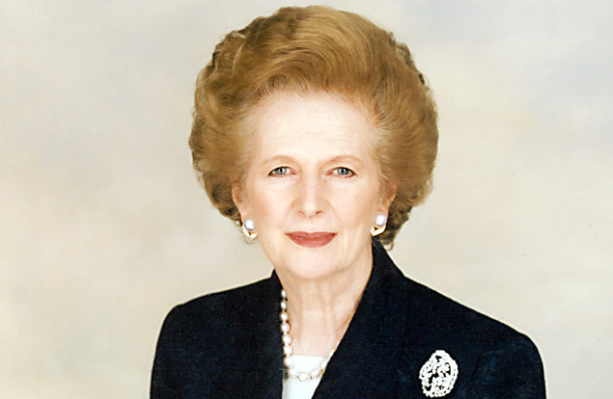
Thatcher’s Prescription

Slide 11
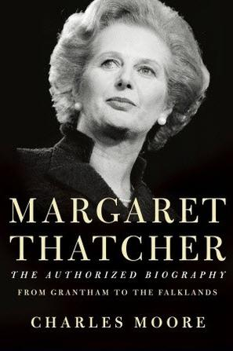
Margaret Thatcher
The Britain 20th century’s longest-serving head of government.
The first female prime minister in Britain history.

Slide 12
Iron Lady
In the 1979 general election, the Conservatives came to power and Thatcher became minister.
In the 1987 general election, Thatcher won an unprecedented third term in office.
In November 1900, she was succeeded as party leader and prime minister by John Major.
The aggressive woman prime minister was compelled to stand down in 1992.

Slide 13
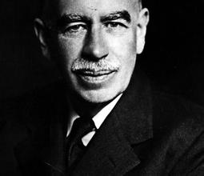
Keynesianism
Keynesianism was put forward by the great British economist John Maynard Keynes;
Keynesianism stressed the importance of government intervention in economy.
Keynesianism argued government should guide and direct a free market economy without changing its capitalist nature.
John Maynard Keynes (1883-1946)

Slide 14
Thatcher’s prescription
1. advocate tight fiscal and monetary policies
to reduce the inflation rate
2. reduce taxes so as to stimulate investment
and consumption
3. sell state-owned enterprises into the
private sector
4. reduce government interference and encourage competition

Slide 15
Result
Remarkable achievement
Regrettable failure
Inflation fell to about 4%
British’s economic growth rate was highest among West European countries
Worker’s take-home pay increased by20%
The general standards of living were higher than before
Two-thirds of English people owned the houses (1/2 →2/3)
Many British people became shareholders
Thatcher’s economic policy achieved remarkable success
The widened gap between incomes (the importance of social justice was neglected)
Crime rates increased
Unsatisfactory social services
The quality of life deteriorated Thatcher’s policy was a bit too pragmatical

Slide 16
撒切尔夫人采取的新自由经济政策至今仍具有借鉴意义。
大力减少国家干预，重视发挥市场机制；推行非国有化政策，鼓励私人经济；
对工会和罢工采取铁腕策略，削减教育、医疗和社会福利等公共开支；
强化与美国的关系，缔造英美联盟；
反对欧洲一体化，捍卫英国固有利益；
与中国就香港问题进行谈判，表现出识时务的一面

Slide 17
所有这些激进且争议巨大的措施被人们称为“撒切尔主义”。支持者认为她带领英国走出经济困境，提升了英国的国际地位；反对者则认为她是一个不折不扣的独裁者、自大狂，几乎毁了英国的福利制度。

Slide 18
Over the past decade, Britain has benefited from a worldwide economic upswing as well as internal improvements.
In 1997 Britain’s economy grew at a rate of 2.5%, one of the highest rates among members of the European Unions.

Slide 19
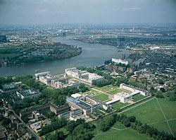
Cities

Slide 20
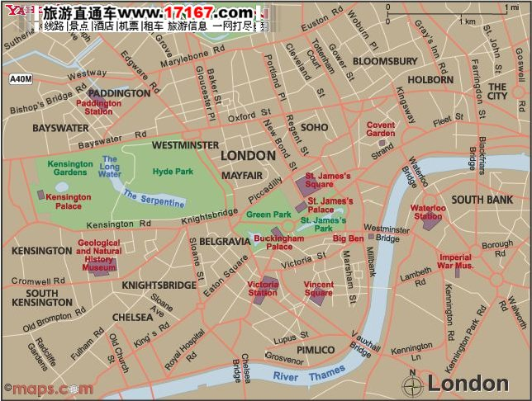
Map of London

Slide 21
London
The capital of the United Kingdom
The largest and most important city in Britain
1610 square kilometers
7 million, more than 11% of Britain’s total population
33 boroughs
One of the 4 leading cities in the world: New York, Paris, Tokyo

Slide 22
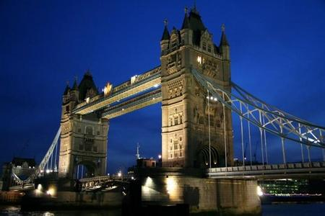
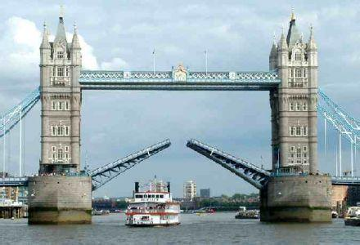
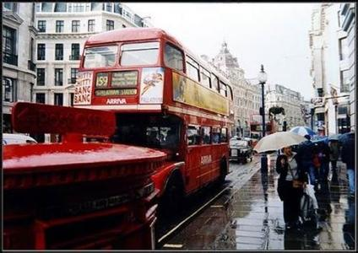
伦敦塔桥 金融街

Slide 23
Central London
The City of London
伦敦城
Central London
伦敦中心城区
City of Westminster
威斯敏斯特城
West End
西区

Slide 24
The City of London
One square mile with only 5000 permanent residents
One of the world’s leading financial centers
Lloyd’s | a famous insurance company
Threadneedle Street | most of the financial activities are crowded along there
The Tower of London | royal treasures
Fleet Street | newspaper industry

Slide 25
The East End
The East End refers to the area to the east of the City of London and the Tower of London.
(slums, poverty, and crime)
Weekend street markets popular
Southwark entertainment center
Tabard Inn The Canterbury Tales
Elizabethan theaters and Globe Theatre

Slide 26
City of Westminster
▲about 2 miles upstream from the city of London
▲ England’s political center of power
(Westminster model)
Westminster Abbey
1. At the heart of Westminster
2. Built in the11th century
3. used for such state occasions as coronations and royal funerals
4. It’s also a giant mausoleum

Slide 27
威斯敏斯特大教堂
坐落在英国伦敦议会广场西南侧的威斯敏斯特大教堂，正式名称为“圣彼得联合教堂”。它最初由笃信宗教的国王“忏悔者”爱德华一世于1050年下令修建，1065年建成。现存的教堂为1245年亨利三世时重建，以后历代都有增建，直到15世纪末才竣工，被认为是英国哥特式建筑的杰作。
威斯敏斯特大教堂既是英国国教的礼拜堂，又是历代国王举行加冕典礼、王室成员举行婚礼的大教堂，还是一个国葬陵墓。
教堂内的“诗人之角”因埋葬14世纪诗人乔叟和文艺复兴时期诗人斯宾塞而得名。后来，英国著名的文学家、艺术家，如莎士比亚和狄更斯、哈代等，都在这里建有墓室或墓碑。此外还有著名的政治家、军事家、科学家如达尔文、牛顿、克伦威尔、丘吉尔等。

Slide 28
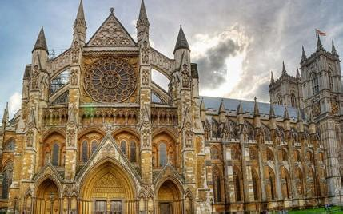
Westminster Abbey

Slide 29
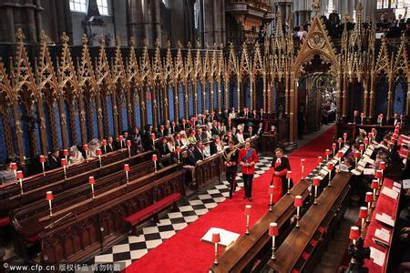

Slide 30
Poets’ Corner a burial ground
The house of Parliament
New Palace of Westminster
New Scotland Yard
the headquarters of the London police
Whitehall English Government
NO. 10, Downing Street English prime minister’s official residence ;prime minister
Buckingham Palace the monarch’s permanent residence
Hyde Park
Speaker’s Corner the epitome of British freedom of speech

Slide 31
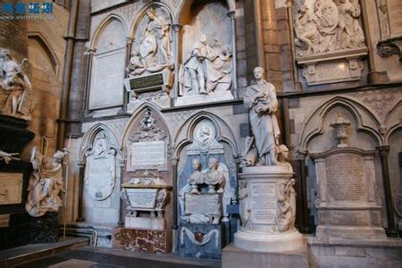
Poets’ Corner

Slide 32
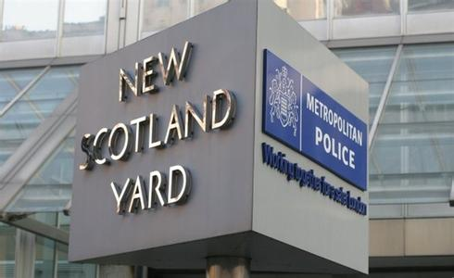

Slide 33
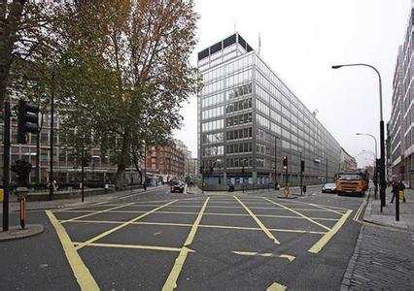

Slide 34
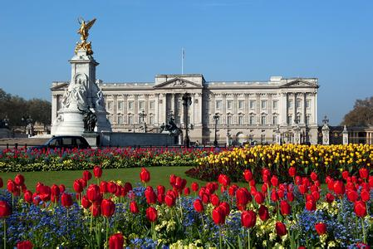
Buckingham Palace

Slide 35
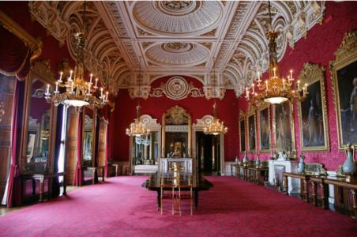

Slide 36
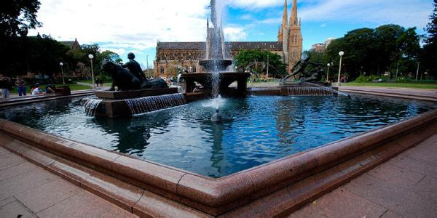
Hyde Park

Slide 37
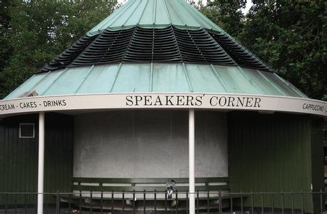
Speaker’s Corner

Slide 38
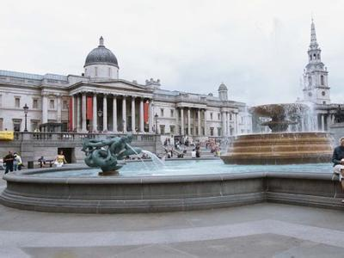
Trafalgar Square
a square in central London
a tourist attraction

Slide 39
West End
London’s shopping and entertainment hub
Oxford Street the busiest shopping area
Soho district The Royal Opera House , most of London’s 40 or so major theaters, the large movie houses, hundreds of restaurants, cafes, and bars
Bloomsbury the city’s traditional intellectual center (Bloomsbury Group)
British Museum
University of London
London School of Economics and Political Science

Slide 40
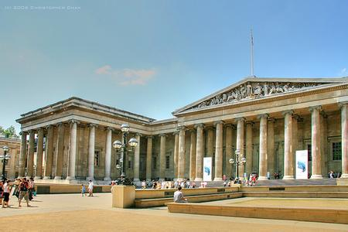
British Museum

Slide 41
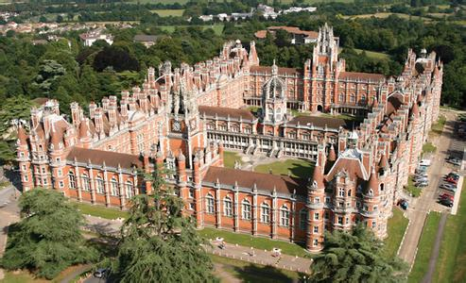
University of London

Slide 42
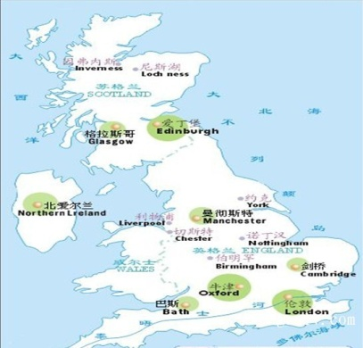
Major Cities

Slide 43
Major Cities
city |  | area | population | university | industries
London | the largest and capital city in Britain | 1 km² | 7 million | University of London
Birmingham | the 2nd largest city in Britain | 264km² | about one million | University of Birmingham | automobiles, electrical equipment, electronics, munitions and arms
Manchester |  | 116 km² | 2.3 million | Victoria University of Manchester | textile industries
Liverpool | the 2nd largest seaport in Britain | 113 km² | 5 hundred thousand | University of Liverpool | food industry engineering
Edinburgh | the capital of Scotland |  |  | University of Edinburgh | grain, fertilizer, and vegetables
Glasgow | the 3rd largest city in Britain |  | 760 000 |  | shipbuilding center
Belfast | the capital city in Northern Ireland | 140 km² | 345 000 |  | shipbuilding &linen
Cardiff | the capital of Wales | 120 km² | 270 000 |  | shipping, Iron& steel
Notes:
1km2

Slide 44
HOMEWORK
Review the knowledge we learned today

Slide 45
Thank you!

