Slide 1
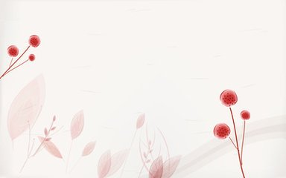
Unit 3 My Friends
boy girl
big small
black yellow
Do you remember?

Slide 2

Unit 3 My Friends
long hair
short hair
strong
thin
quiet
Let’s read!

Slide 3

My friend is …
She has …
He has …
let’s learn!

Slide 4
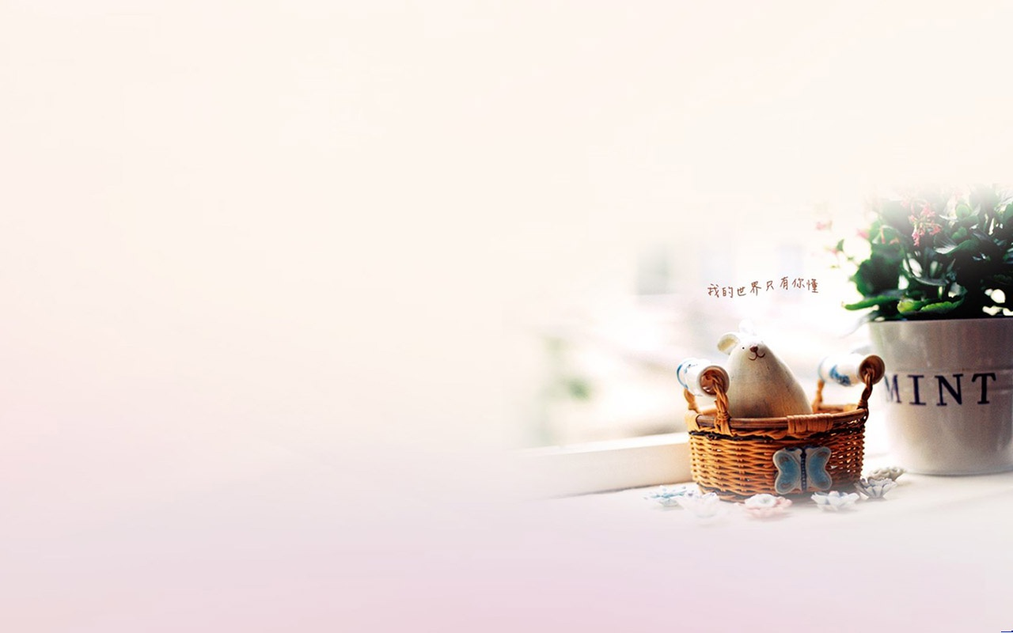
Unit 3 My Friends
A:Mom,I have a new friend.
B:A Chinese friend?
A:yes.
B:A boy?
A:yes,he has short black hair and big eyes.
B:what is his name?
A:His name is Zhang Peng .
B:Look,this is his photo. He is tall.
A:He is strong, too.
Let’s talk!

Slide 5
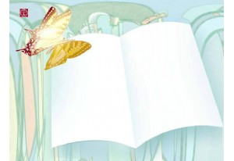
Practice1:
thin friend quiet long hair
I have a ____, and she has _____.She likes to listen to music. She is ____ and ____.I like her very much.

Slide 6

Practice2:
Work with your partner and introduce your friends to your partner in English.

Slide 7
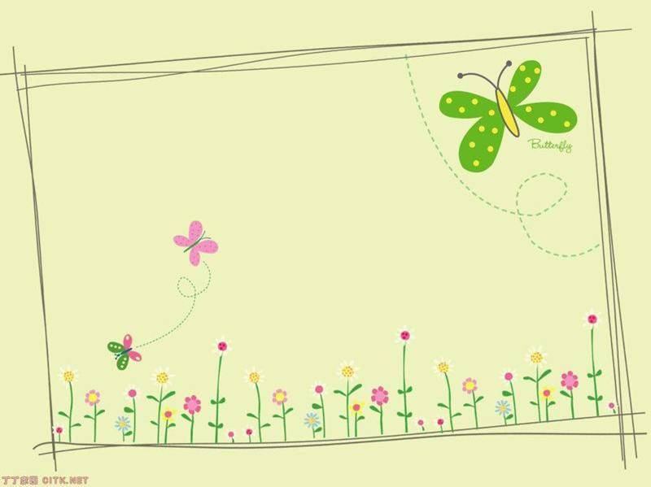
Homework:
Write a short passage about one of your friends and introduce her or him to your family.

Slide 8
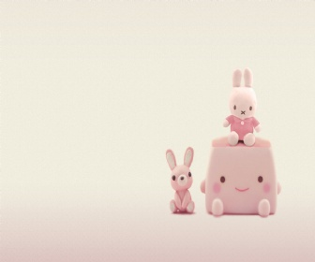
Thanks for your attention!
外国语学院
英语121班
何建霞

