Slide 1

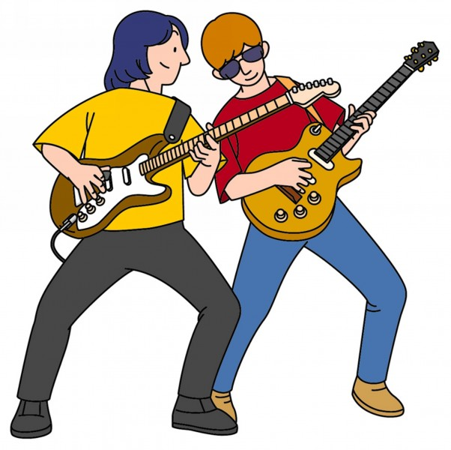
外国语学院
英语123班
刘玉兰

Slide 2

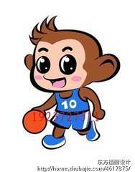
Unit 10 I am going to be a basketball player
language goal（语言目标）：
talk about future intention(谈论将来的想法)

Slide 3

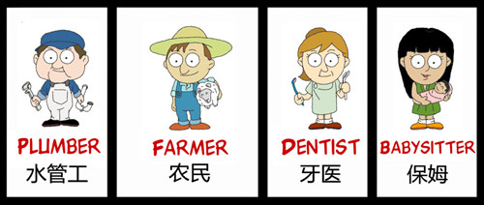
Learn some new words

Slide 4
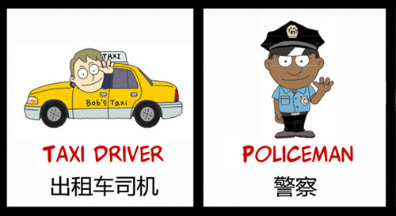

Slide 5
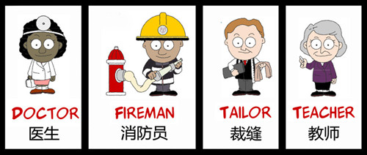

Slide 6
What are you going to be when you grow up?
I am going to be a doctor.
I am going to be a teacher

Slide 7
How are you going to do that?

Slide 8
I am going to study English hard
take piano lessons
practice basketball everyday
study science
do more exercise
read more books
help other people

Slide 9

group work
what are you going to be when you grow up?
I am going to be a (an) basketball player
How are you going to do that?
I am going to practice basketball everyday.

Slide 10



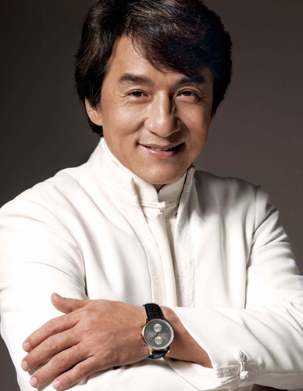

Guessing their jobs

Slide 11
              Homework
Write a short paragraph to introduce the jobs of your family members to your friends.

