Slide 1

My Friends
外国语学院
英语124班 张娇
20120401050731

Slide 2



My Friends

Slide 3
Contents
1.Warming-up
2.Presentation
3.Practise
4.Homework

Slide 4
学习目标
1.能听懂、会说 What’s his name?
His name is…
He has…
2.能听、说、认读 I have a new friend.
A Chinese friend?
What’s his name?
His name is…

Slide 5
Presentation
What’s his name?
His name is…
He has…

Slide 6
Practice

Slide 7

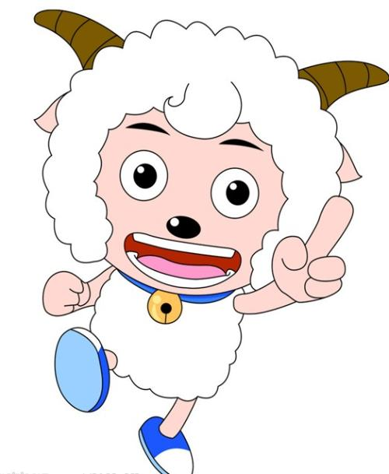
What’s his name?
His name is
He has…
Xiyangyang

Slide 8
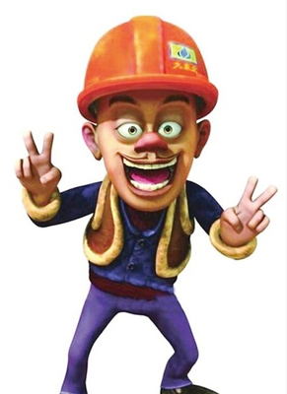
What’s his name?
His name is
He has…
Guangtouqiang

Slide 9
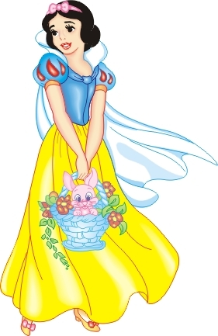
What’s her name?
Her name is
She has…
Bai xue gong zhu

Slide 10
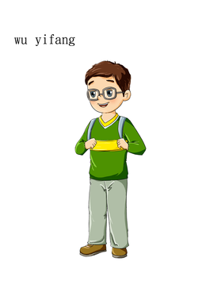
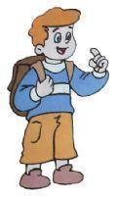
Guess
1. A: My friend is thin. He
has short hair. What’s his name?
B: His name is
2. A: My friend is strong. He
has short hair. What’s his name?
B: His name is
Wu yi fan
Zhangpeng

Slide 11
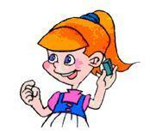
3. A: My friend is very nice.
She has long hair.
What’s her name?
B: Her name is
Sarah

Slide 12
考考你
1. 他有一个小小的鼻子。（用适当的形式填空）
He___(has/have) a small nose.
2. 他叫什么名字？（补全句子）
___ ___ name?
3. 李华有一头黑色的头发。（补全句子）
Li Hua has ___ ___ hair.

Slide 13
Homework:
1.Describe your friends or your
classmates and so on.
2.Listen and read the dialogue.
3.Copy the dialogue one.

Slide 14
My Friends
Thank You !

