Slide 1
Unit 4
Astronomy: the Science of the Stars
第一课时教学设计方案
院系:外国语学院
班级:英语121
姓名:宋丹丹
学号:20120401050315

Slide 2
（一）教学目标：
知识目标：了解太空行走时产生重力以及相应的体重变化。
能力目标：学生能掌握泛读技巧——寻读；能够归纳出月球旅行的三次重力及相应体重的变化；学生能够加强口头表达能力，提高解决问题能力。
情感目标：通过学习天文学的相关知识，学生能够加强对太空科学的热爱并且能够展开想象的翅膀，展望和设计未来的“美好家园”

Slide 3
㈡教学重点：
学习Scanning和Careful reading的技巧
㈢教学难点：
阅读技巧如寻读，归纳
（四）教具媒体：
教材相配套的教学课
（ Unit 4 Astronomy: the Science of the Stars）

Slide 4
（五）教学过程：
Step 1 Lead in by introducing Space Home Pavilion in Shanghai World Expo.
T: Hello everyone! Do you know what big event happened last year in our country, in Shanghai?
S: Shanghai World Expo
T: That’s it! So have you ever visited it?
S: No. (mostly)
T: Believe it or not, today we just get a chance to pay a visit to one pavilion there. That is, Space Home pavilioin. Are you familiar with it? （No!）Never mind! Let me introduce it to you.

Slide 5
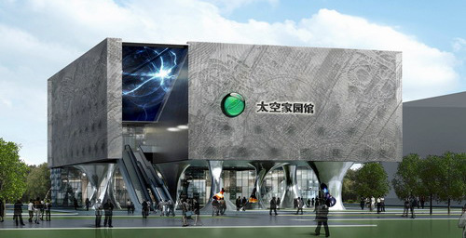
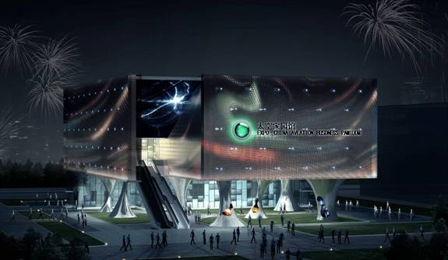

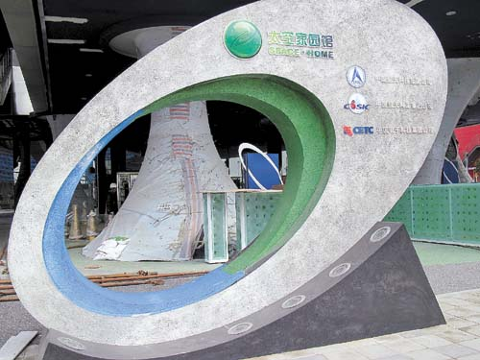

Slide 6
Step 2: Preparation before visit—a competition on space knowledge
1.Earth is the only planet moving around the sun. (T or F)
2.There is atmosphere on the moon
3.In our solar system eight planets circle around the sun.
4.____ was the first person landing on the moon? (Multiple choice)
A. Armstrong B. Yang Liwei C. Tom Cruise D. Issac Newton
5. When did he land on the moon?
A. 1921 B. 1969 C. 1954 D. 1949
6. When did Yang Liwei go to the space?
A. Oct, 2003 B. Jan, 2003 C. Oct, 2004 D. Jan, 2002
7. Which country first sent people up to space?
A. USA B. the Soviet Union C. China
8. So far, how many countries have succeeded in sending people up to space?
F 1 T 2 T 3 A 5 B 6 C 7 D 8

Slide 7
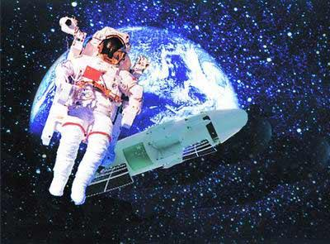
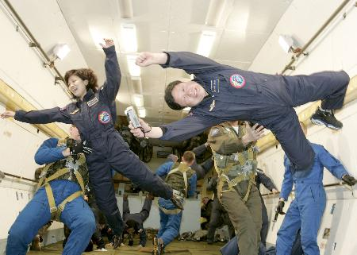
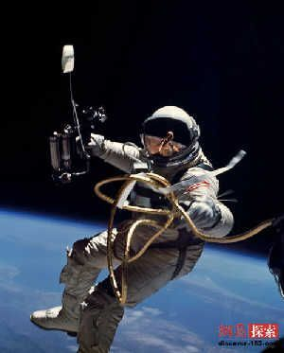
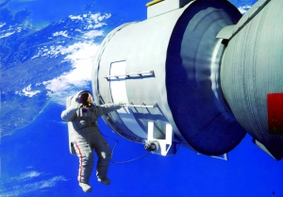
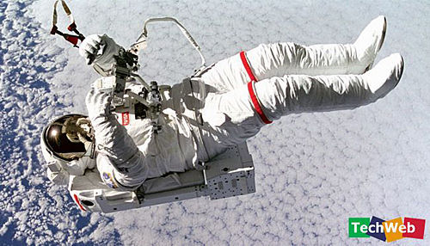
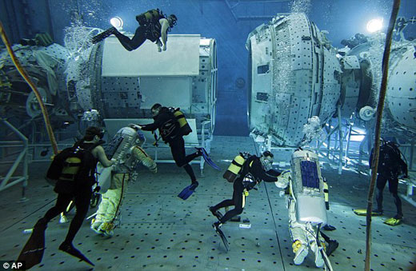
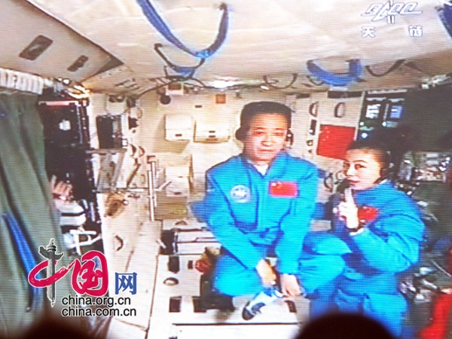

Slide 8
Step 3: The Second stop—Spacewalk (Reading)
Reading: a visit to the moon
Activity 1: Scanning
1. Who do I have a chance to travel to the moon with ?
2. How did we travel to the moon?
3. What’s the writing order in this text?
4. How many times would the force of gravity change on our journey?
Which change would be the most powerful?
Activity 2: Careful reading
Read Para.2 and underline the sentences about the gravity and our weight during the journey. Pay special attention to their three times’ of changes. Then do the following match work.
1.What happened to me when I tried to step forward? Why?
2.Why was returning to the earth very frightening?
How did I feel?

Slide 9
Step 4: The Third Stop: Wonderful Home—Discussion (Speaking)
Suppose someday we are going to live on the moon, what problems will you meet with? To solve these problems, what things will you take?
Example: If I lived on the moon, I might have problems. The first one is···· Because ···· To solve this problem, I would take····with me. The second one is ···· ····
Group 1…Group 2…
Problems: How to breathe; what to eat; how to cool you; what to dress…
Solutions: oxygen tanks, space food; water; spacesuit…
Step 5: Write a report on your visit—Assignment
Write down what you’ve talked about in step 4

Slide 10
六、课堂板书
阅读技巧:寻读和仔细读
太空知识竞赛答案：F 1 T 2 T 3 A 5 B 6 C 7 D 8

Slide 11
Thank you

